Slide 1
Student Management System

Slide 2
Members
Malek Burhaan
Shaikh Mohd Arsh
Sheth Mahamad Sarjil

Slide 3
Introduction
A centralized platform for managing student-related activities.
Streamlines attendance tracking, marks management, and result generation.
Provides secure access to academic records for students.
Ensures transparency and accessibility in student progress tracking .
Reduces manual effort for administrators and teachers.

Slide 4
1.2 Need for the new system:
Modern and Efficient: The new system replaces old, slow methods, making everything faster and more accurate.
Simplified Tasks: It makes tracking attendance, managing grades, and monitoring progress easier for everyone.
Instant Access: Students, teachers, and administrators can see real-time information whenever they need it.
Student Responsibility: Students can check their grades and track their progress, helping them stay on top of their work.
Less Work for Admins: The system makes it easier for administrators to manage data and reduce errors.
Better Communication: Everyone gets the latest updates quickly, improving how people communicate.
Better Decisions and Growth: The system helps everyone make better decisions and supports student progress.

Slide 5
1.3 Problem Definition:
Old and Slow: The current manual system is outdated, causing delays and frequent mistakes in tracking attendance, marks, and results.
Hard for Students: Students have trouble accessing their academic records quickly.
Time-Consuming for Admins: Administrators spend too much time managing data manually.
Poor Communication: Without a centralized system, there are missed updates and a lack of transparency.
Need for Change: The system must be replaced with an automated one to ensure accurate, real-time data and improve overall efficiency.

Slide 6
1.4 Objective of New System:
Automate Tasks: The new system will automate tasks like attendance, marks, and results to make everything faster and more accurate.
User-Friendly: It will be easy for both students and administrators to use, improving the overall experience.
Reduce Manual Work: The system will cut down on the time and effort needed for manual work, making processes more efficient.
Better Communication: It will improve communication and ensure everyone has timely access to important information.
Improved Experience: The system will make managing academic information easier, leading to a better educational experience for all.

Slide 7
1.5 Core Component:
Student Profile Management: Stores student details and academic history.
Attendance Tracking: Records and monitors student attendance.
Marks Management: Tracks and updates student marks.
Result Posting & Access: Allows administrators to post and students to access results securely.
Progress Monitoring: Tracks student progress over time.
Admin Dashboard: Centralized management of student records and reports.
Communication System: Enables communication between students, and administrators.
Security & Data Protection: Ensures secure access and protects student data.

Slide 8
1.6 Project Profile:
Project Title | Student Management System
Project Developer | Malek Burhaan (Eno.21018501210027) Shaikh Arsh (Eno. 21018501210060) Sheth Sarjil (Eno. 21018501210060)
Hardware Require | Pentium 4 Micro Processor or Above RAM 1 GB or Above Hard Disk 60 GB or Above
Software Require | Window XP or Above
Front End | React Js
Framework | MERN Stack
Back End | Node Js Express Js
Other Tools | MS Word 365 (Documentation) MS PowerPoint (Presentation) Dia (Diagram)
Project Internal Guide | Prof. Harsh
Duration | 36 Days

Slide 9
1.7 Advantages and Limitations of the Proposed System Advantages:
Efficiency: Automates tasks like attendance tracking, marks management, and result posting, reducing manual effort and saving time.
Accuracy: Minimizes human errors in data entry and record-keeping.
Real-time Access: Provides students and administrators with immediate access to academic records and results.
Transparency: Enhances visibility and accountability by allowing students to track attendance and academic progress.
Improved Communication: Facilitates better communication between students , administrators through a centralized platform.
Data Security: Ensures secure handling and access to student data through robust protection measures.

Slide 10
1.7 Advantages and Limitations of the Proposed System Limitations:
Internet Dependency: The system requires internet access, which may not be available to all users at all times.
User Training: Proper training is essential for administrators and students to maximize system effectiveness.
Implementation Costs: Initial setup and ongoing maintenance may incur significant costs.
Device Compatibility: The system may have limitations when accessed on older or incompatible devices.
Data Privacy Concerns: Handling sensitive student information may raise concerns regarding privacy and data protection regulations.

Slide 11
1.8 Assumptions and Constraints
Assumptions:
All students and administrators will have access to the internet and necessary devices.
Students will provide accurate and up-to-date personal information.
Administrators will be trained in using the system for data entry and result management.
The system will be implemented in a secure and reliable environment with regular backups.
Constraints:
The system may face limitations due to network connectivity issues or device compatibility.
Data security and privacy regulations may impose limitations on data storage and access.
The system's effectiveness may depend on user adoption and proper training.
Implementation may be constrained by budget and time limitations for development and maintenance.

Slide 12
2.Requirement Determination & Analysis 2.1. Requirement Determination
Objective: Develop a system to manage and store student academic records, calculate results, and provide secure access for students, faculty, and administrators.
Key Features:
Student Data Management: Add, update, and delete student profiles.
Course Management: Assign subjects and manage course details.
Marks Entry and Grading: Input marks, calculate grades, and generate results.
Result Generation: Publish results and allow students to view/download them.
User Roles: Role-based access for students, faculty, and administrators.

Slide 13
2.Requirement Determination & Analysis 2.1. Requirement Determination
Non-Functional Requirements:
Security: Encrypt sensitive data and ensure secure access.
Usability: Simple and intuitive interface for all users.
Scalability: Handle increasing student data efficiently.
Accessibility: Ensure mobile and desktop compatibility.
Constraints: Limited budget, strict deadlines, and compliance with data protection laws.
Tools and Technologies: Use a robust database (e.g., MySQL), web technologies (e.g., HTML, CSS, JavaScript), and cloud hosting for scalability.
This system aims to ensure accurate, efficient, and secure management of student results.

Slide 14
➢ Hardware Requirements
The system requires the following minimum hardware specifications for optimal development and deployment:
Processor: Intel(R) Core (TM) i5-6040U CPU @ 2.3GHz or higher
Memory: 4GB RAM (8GB recommended for smoother multitasking)
Storage: 256 GB SSD or higher
➢ Software Requirements
The following software stack will be used to develop and deploy the application:
Operating System: Windows 10 or higher / macOS / Linux
Database: MongoDB for scalable and efficient data handling
Development Tool: Visual Studio Code, chosen for its robust development environment
Framework: MERN Stack (MongoDB, Express.js, React.js, Node.js) for modern and scalable web development

Slide 15
2.2. Targeted user:
➢ Students :
Access and view their academic results securely.
Download or print result reports.
Faculty Members
Enter student marks and evaluate performance.
Manage subject-wise grading and attendance (if applicable).
Administrators
Oversee the system, manage user accounts, and handle data backups.
Configure grading criteria, academic years, and result publication schedules.
Parents/Guardians (Optional)
View student results and performance updates.
System Developers/Maintainers
Ensure smooth functioning, troubleshoot issues, and implement updates or new features.

Slide 16
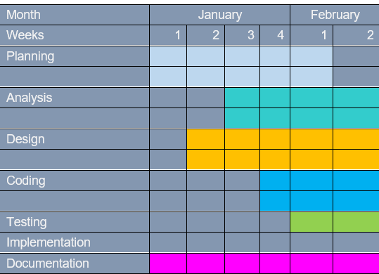
2.3. Proposed Timeline Chart

Slide 17
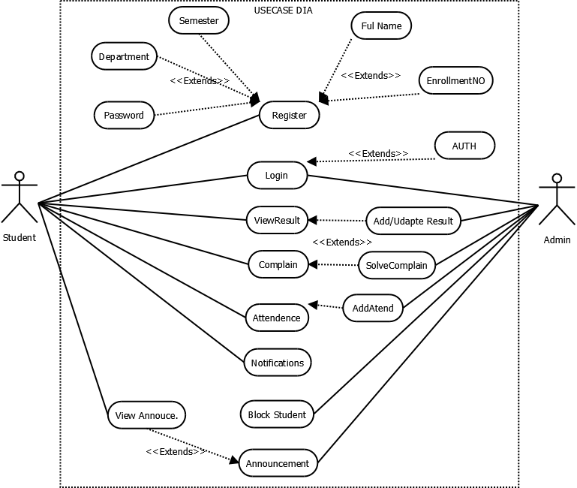
3. System Design 3.1. Use Case Diagram

Slide 18
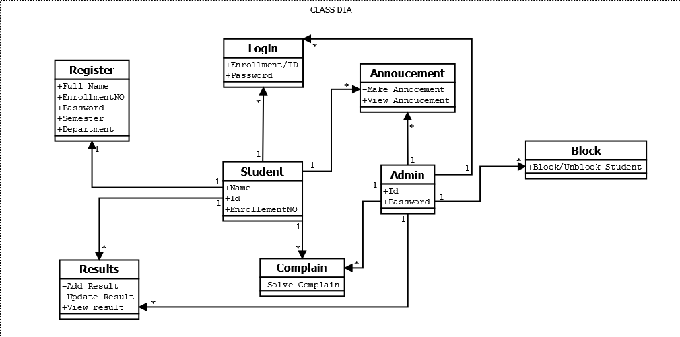
3.2. Class Diagram

Slide 19
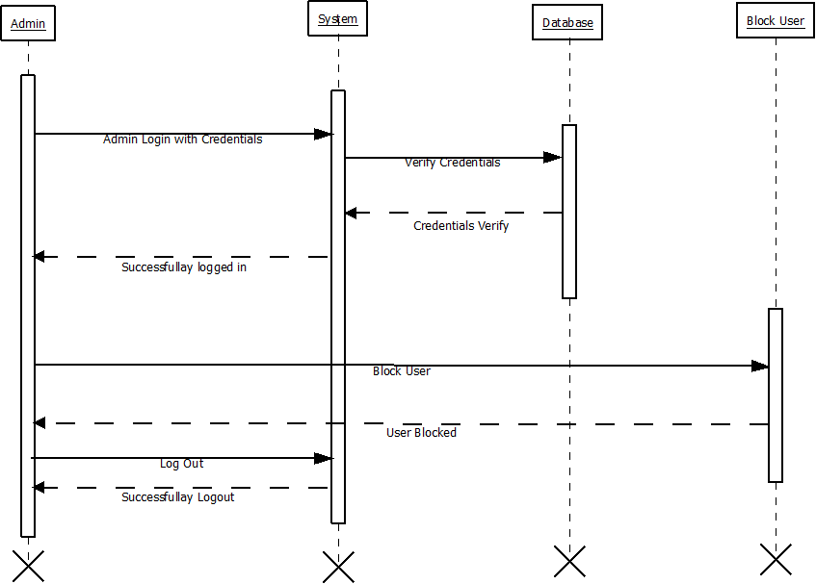
3.3. Interaction Diagram ⮊ Interaction Diagram for Blocking user

Slide 20
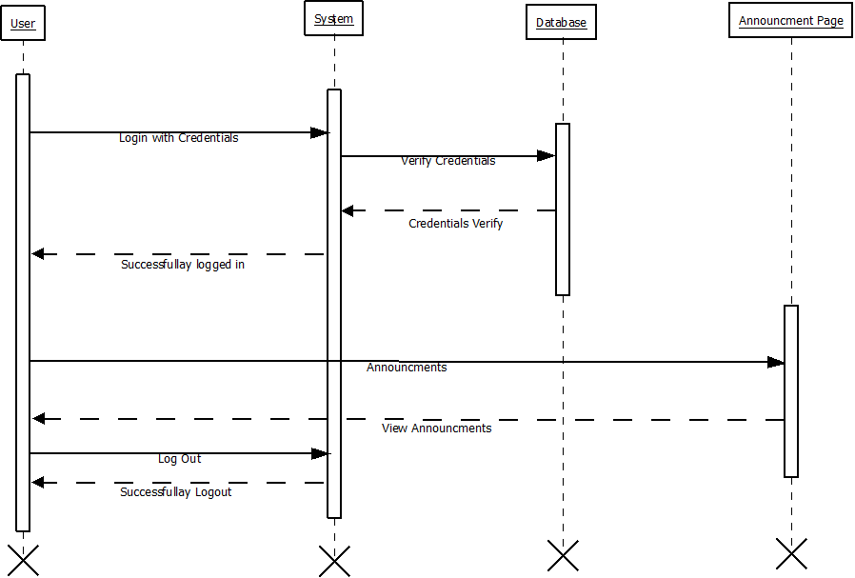
3.3. Interaction Diagram ⮊ Interaction Diagram for Announcment

Slide 21
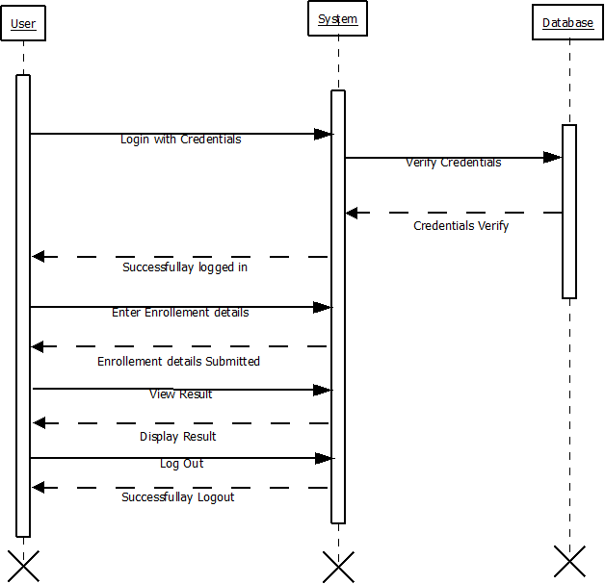
3.3. Interaction Diagram ⮊ Interaction Diagram for Result :

Slide 22
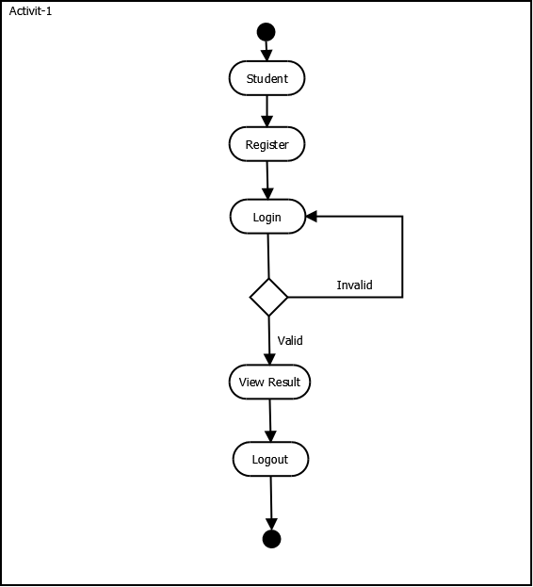
3.4. Activity Diagram Activity Diagram for View Result

Slide 23
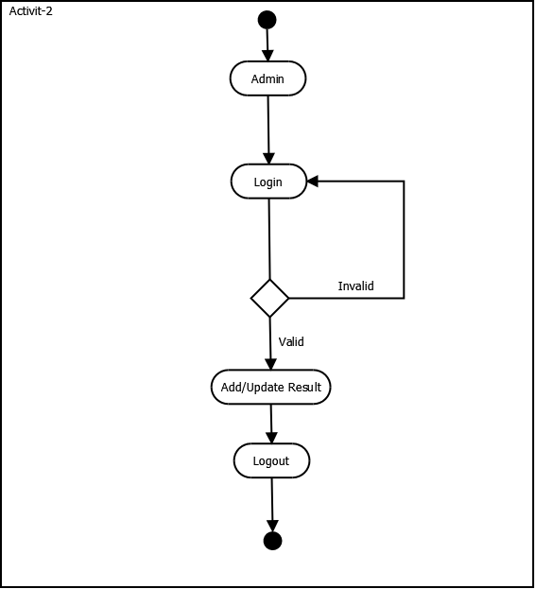
Activity Diagram for Add/Update Result :

Slide 24
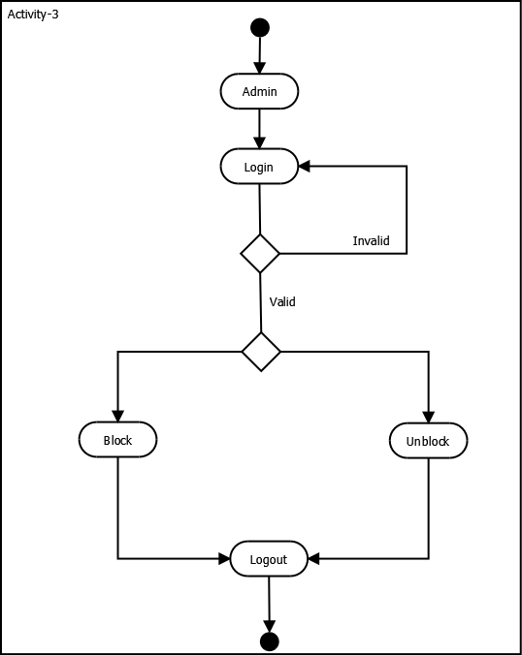
Activity Diagram for Blocking Student :

Slide 25
5. Data dictionary:

Slide 26
Table Name: Student
Table Description: Stores the basic details including name, address and contact numbers of each branch of the bank
Table Level Constraints (if any):
Field Name | Data Type <with Size> | Constraint | Description | Sample Data
user_ID | Char(6) | Primary Key | Branch Code/Identification | 079001
Student_Name | Varchar(30) | Not Null | Name of the Student | Arsh
Enrollment_Number | Char(12) | Not Null | Enrollment Number | 2100185
Password | Varchar(30) | Not Null | Password | 1234567
Conform_Password | Varchar(30) | Not Null | Conform Password | 1234567
Division | Varchar(30) | Not Null | Student Division | D
Department | Varchar(30) | Not Null | Department | IMCA
Semester | Char(12) | Not Null | Semester | 5
Roll_Number | Char(12) | Not Null | Roll Number | 61

Slide 27
Table Name: Login History
Table Description: Stores the basic details including name, address and contact numbers of each branch of the bank
Table Level Constraints (if any):
Field Name | Data Type (with Size) | Constraint | Description | Sample Data
Role | Varchar(30) | Primary Key | Role | Admin
User_type | Varchar(30) | Not Null | User type | Student
Login_Time | Date | Not Null | Login Time | 10:50 AM
Task | Varchar(30) | Not Null | Task | Login,Logout

Slide 28
Table Name: Notification
Table Description: Stores Details of Each Credit Card Issued by a branch
Field Name | Data Type (with Size) | Constraint | Description | Sample Data
User_ID | Char(16) | Primary Key | USER ID | !
Message | Varchar(30) | Not Null | Message | Hello
Type | Varchar(30) | Not Null | Type | Hello Students
Read | Boolean | Not Null | Read
Created_at | Date | Not Null | Created at | 10-5-2023
Pincode | Char(6) | Not Null | Pincode | 380015

Slide 29
Table Name: Result
Table Description: Stores Details of Each Credit Card Issued by a branch
Field Name | Data Type (with Size) | Constraint | Description | Sample Data
Role | Varchar(30) | Primary Key | Role | Student
result_id | Varchar(30) | Not Null | User type | 30
user_id | Date | Not Null | Login Time | 10-5-2024
subject | Varchar(30) | Not Null | Task | ENGLISH
marks_obtained | Char(10) | Not Null | Marks Obtained | 30
total_marks | Varchar(30) | Not Null | Total Marks | 50
grade | Char(10) | Not Null | Grades | A

Slide 30
Table Name: Complaints
Table Description: Stores Details of Each Credit Card Issued by a branch
Field Name | Data Type (with Size) | Constraint | Description | Sample Data
Role | Varchar(30) | Primary Key | Role | Student
result_id | Varchar(30) | Not Null | User type | 30
user_id | Date | Not Null | Login Time | 10-5-2024
subject | Varchar(30) | Not Null | Task | ENGLISH
marks_obtained | Char(10) | Not Null | Marks Obtained | 30
total_marks | Varchar(30) | Not Null | Total Marks | 50
grade | Char(10) | Not Null | Grades | A

Slide 31
4. Development
4.1. Coding standards:
1. Follow naming conventions in variable name and methods name.
2. Give minimum two spaces between operator and operand.
3. Give proper indentation.

Slide 32
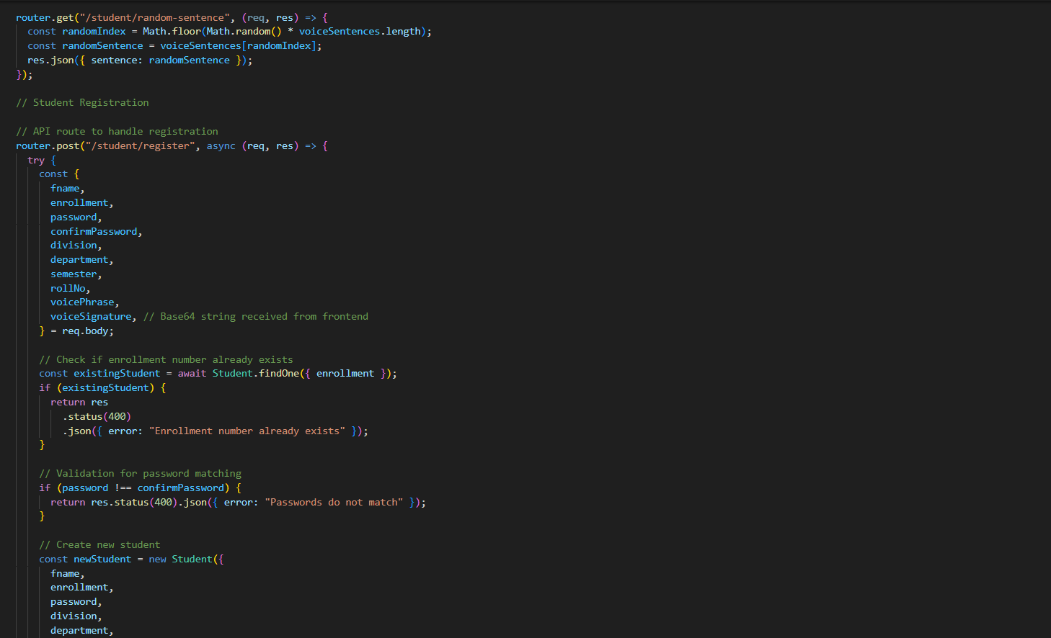
• StudentRegistration BackEnd:

Slide 33
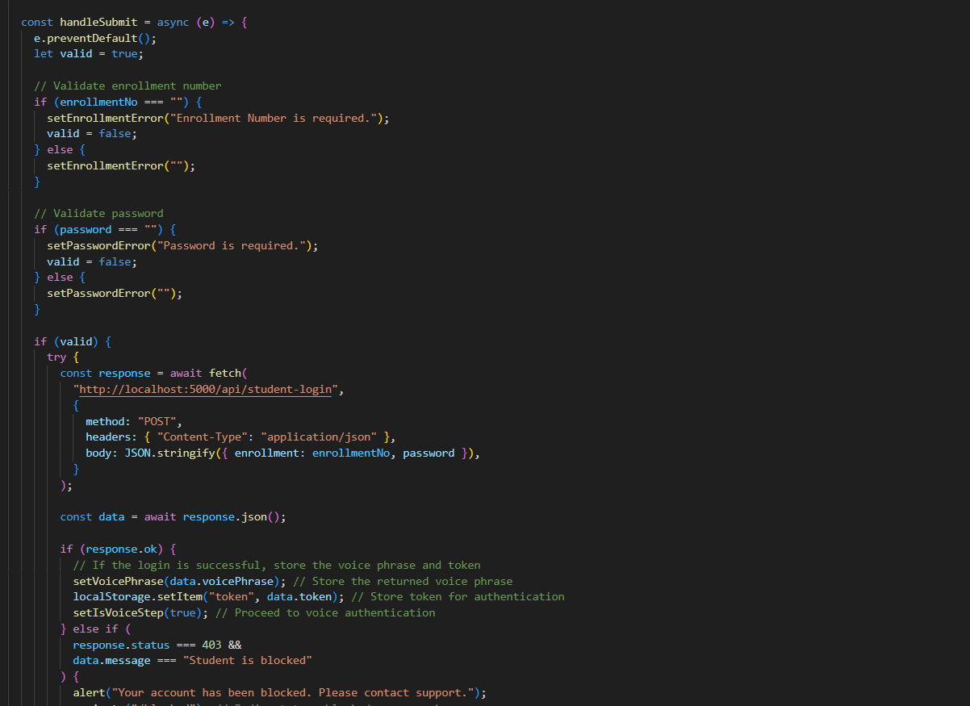
• Code Student Login

Slide 34
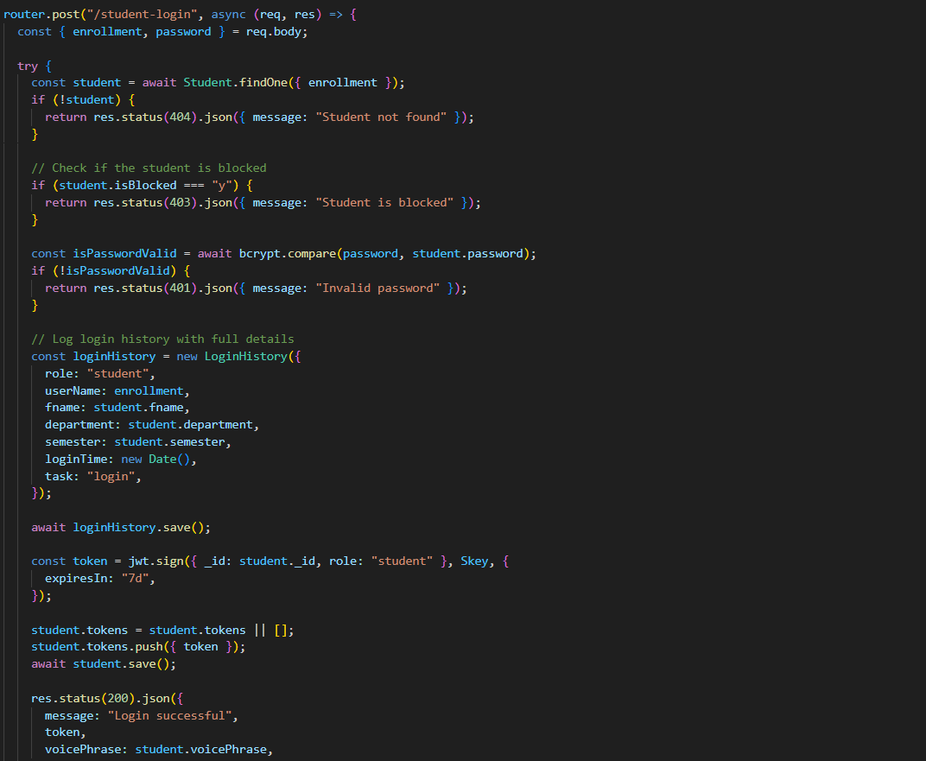
• StudentLogin BackEnd

Slide 35
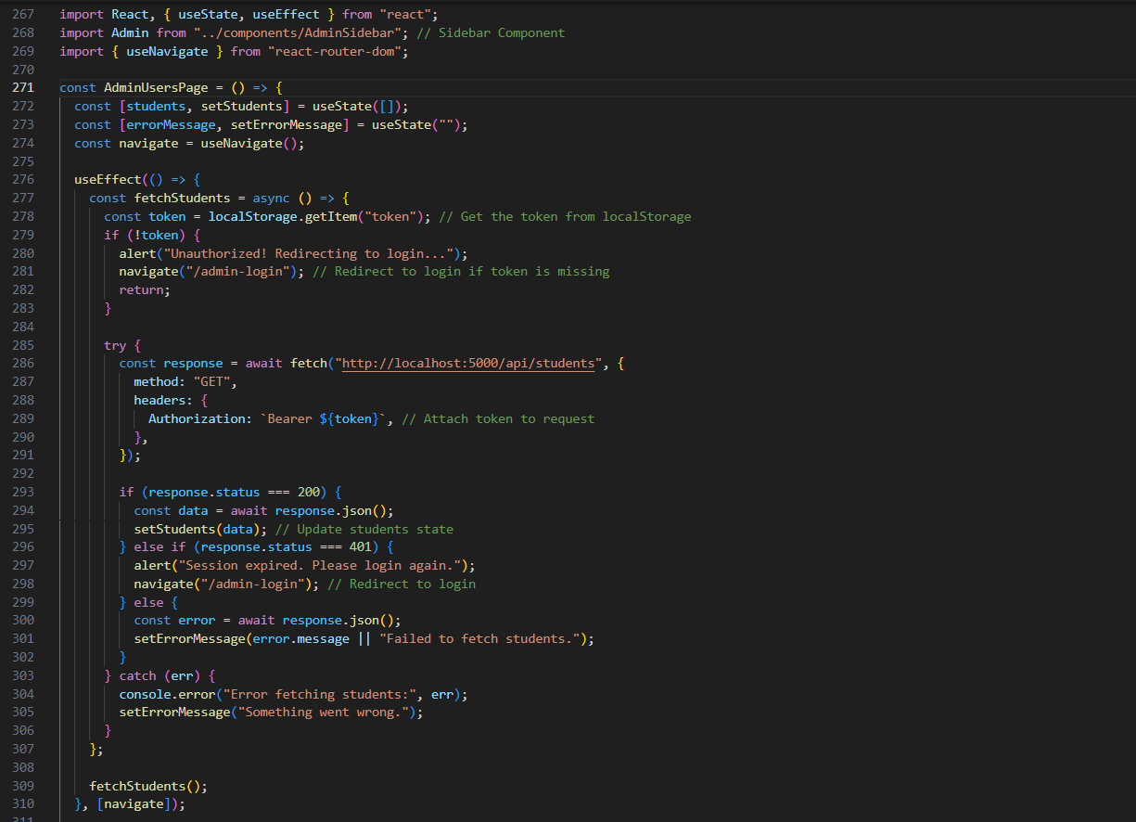
• Code Admin Panel

Slide 36
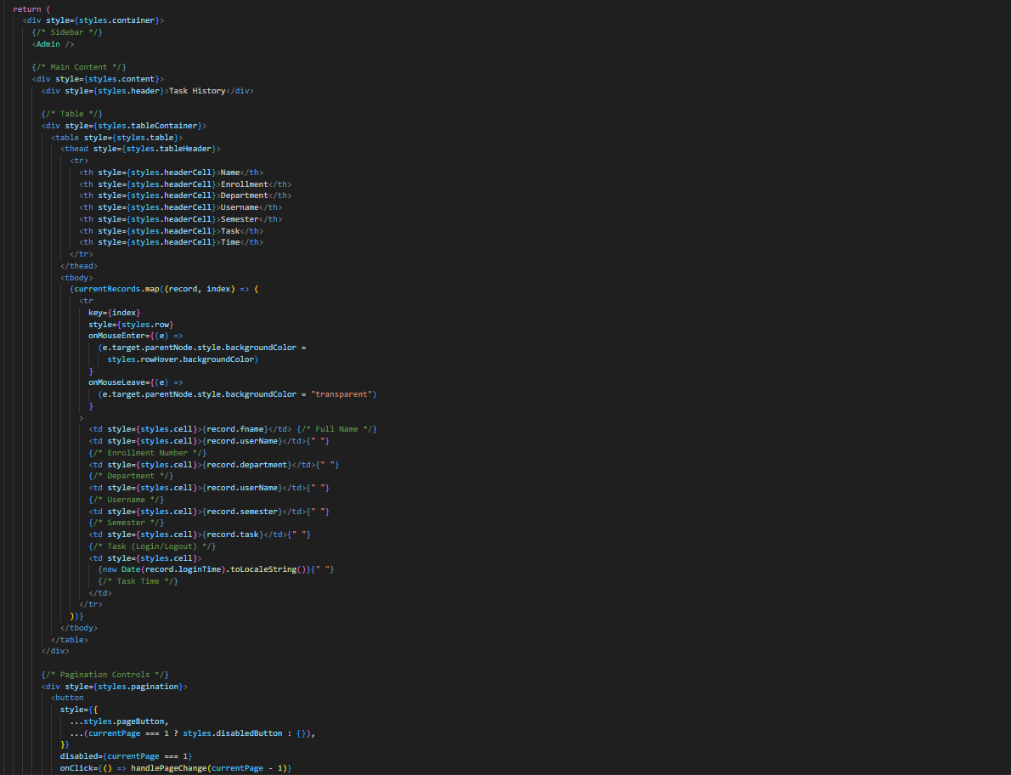
• Code of Complain page

Slide 37
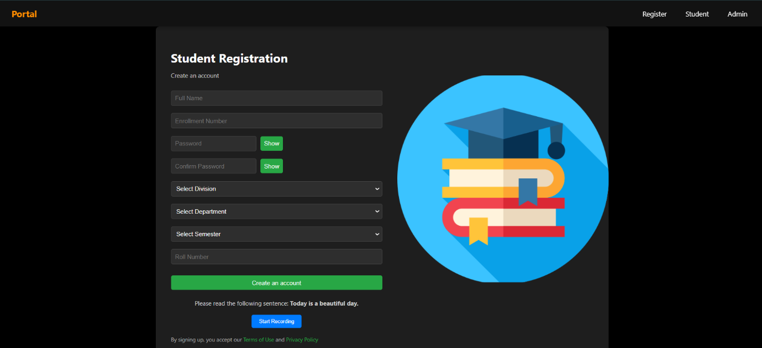
4.2. Screen shots

Slide 38
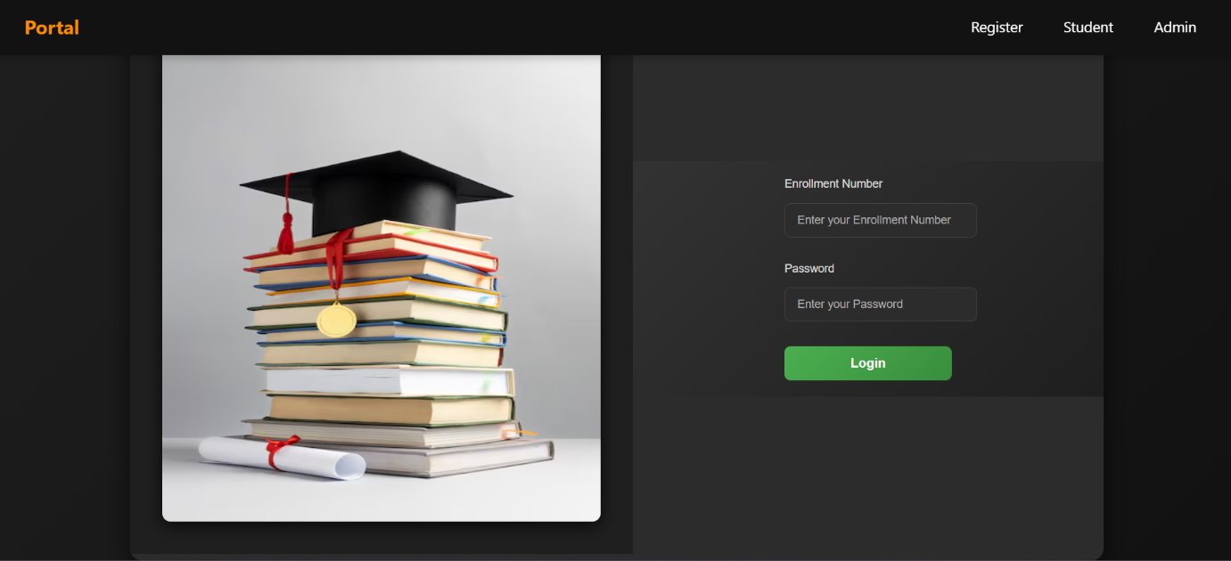
4.2. Screen shots

Slide 39
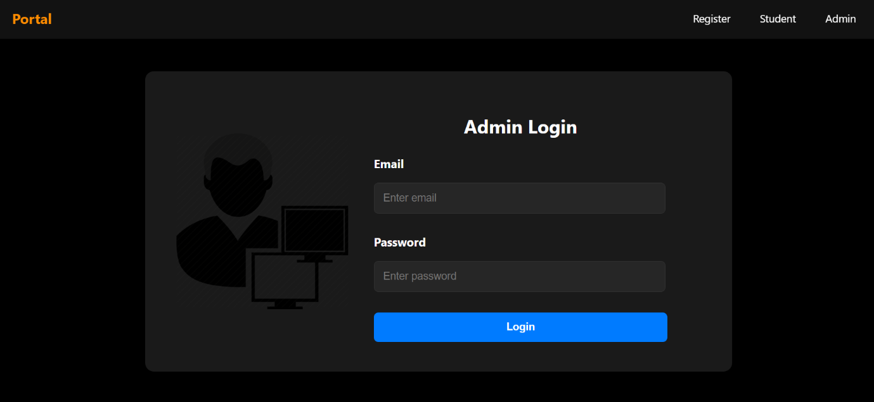
4.2. Screen shots

Slide 40
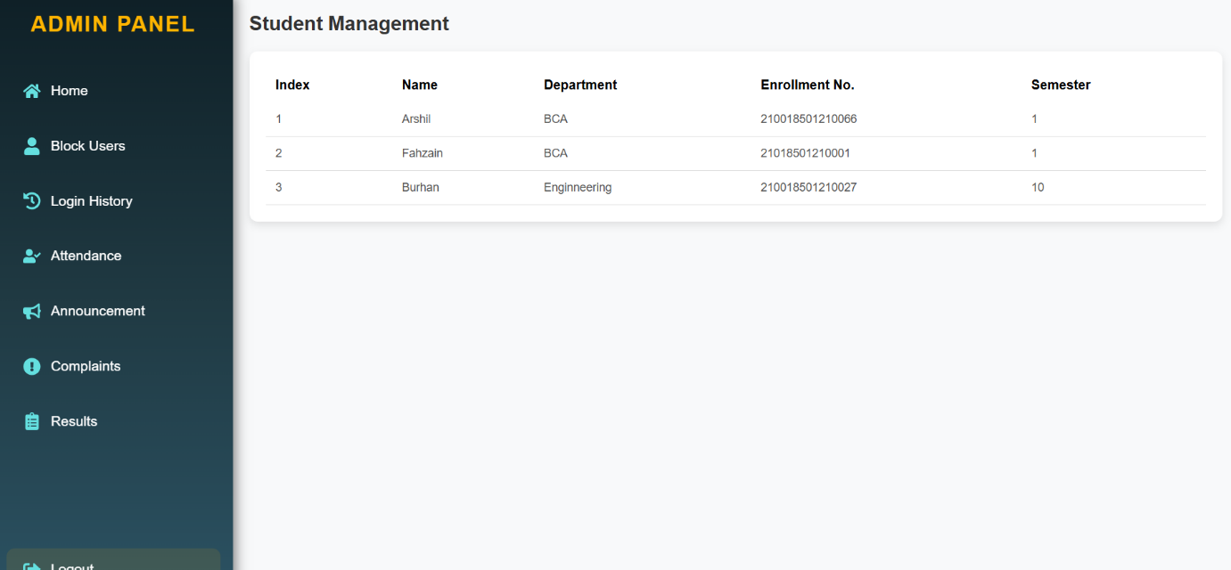
4.2. Screen shots

Slide 41
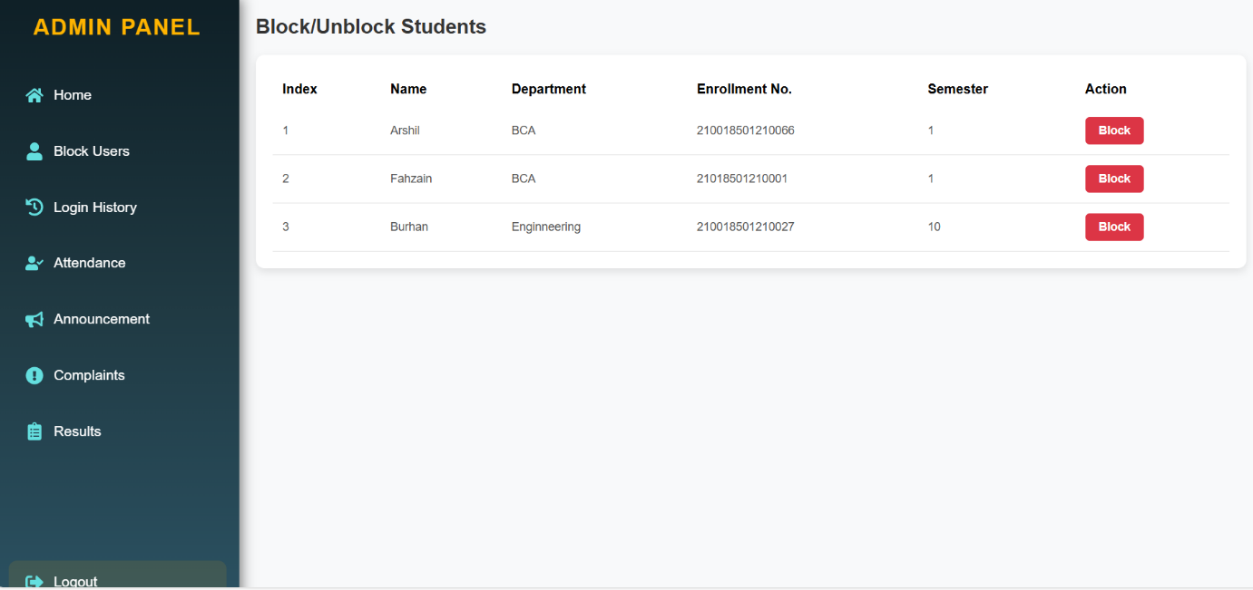
4.2. Screen shots

Slide 42
5. Agile Documentation 5.1 Agile Project Charter
General Project Information
Project Name | Student Management System
Project Champion | Malek Burhaan, Sarjil Sheth, Arsh shaikh
Project Sponsor | LJ Institute of Computer Application
Project Manager | Prof Harsh
Expected Start Date | 06/01/2025
Expected Completion Date | 12/02/2025

Slide 43
5. Agile Documentation 5.1 Agile Project Charter
Project Details
Mission | Our goal is to provide a safe and easy-to-use platform that helps both students and schools manage information. The system makes it easier to track student details, attendance, and grades, while also improving school operations. By allowing better communication between students, teachers, and staff, it aims to support learning and help make better decisions.
Vision | Our vision is to build a simple and effective platform that helps schools easily manage student information and supports better communication. We want to make it easier for students and staff to work together, improving the overall learning experience and making University operations run smoothly.
Scope | The Student Management System will help schools keep track of student info like attendance, grades, and personal details. It will also let teachers and staff manage academic performance and send updates to students and parents. The system will be easy to use, safe, and designed to fit the needs of University of all sizes.
Date | 06/01/2025

Slide 44
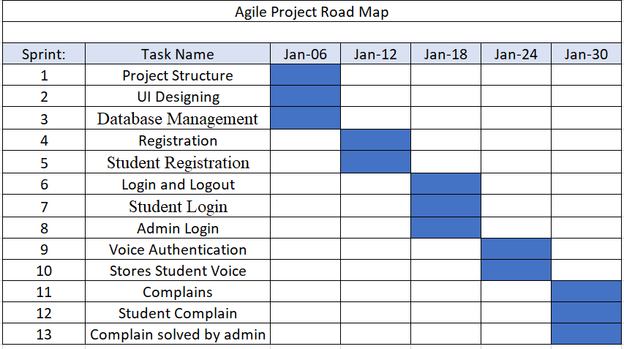
5.2 Agile Roadmap / Schedule

Slide 45
5.3 Agile Project Plan
Task Name | Duration | Start | Finish | Status
Sprint#1 : Project Structure | 2d | 06/01/2025 | 08/01/2025 | Completed
UI Designing | 1d | 08/01/2025 | 09/01/2025 | Completed
Database Management | 2d | 09/01/2025 | 11/01/2025 | Completed
Sprint#2 : Registration | 1d | 11/01/2025 | 12/01/2025 | Completed
Student Registration | 1d | 12/01/2025 | 13/01/2025 | Completed
Sprint#3 : Login and Logout | 1d | 13/01/2025 | 14/01/2025 | Completed
Student Login | 1d | 14/01/2025 | 15/01/2025 | Completed
Admin Login | 1d | 15/01/2025 | 16/01/2025 | Completed
Sprint#4 : Voice Authetication | 3d | 16/01/2025 | 19/01/2025 | Completed
Stores Student voice | 2d | 19/01/2025 | 21/01/2025 | Completed
Sprint#5 : Complains | 1d | 21/01/2025 | 22/01/2025 | Completed
Students Complains | 1d | 22/01/2025 | 23/01/2025 | Completed
Complains Solved by admin | 1d | 23/01/2025 | 24/01/2025 | Completed

Slide 46
5.4 Agile User Story
User Story ID | As a (type of user) | I want to (perform some task) | So that I can (achieve some goal)
1 | Admin | Manage Login Module | Ensure that validate Students can join
2 | Admin | Manage Courses | Insert, Update Delete and View the Courses
3 | Admin | Manage Announcements | Make announcements for the students
4 | Student | View Results | View Results
5 | Student | Select Results | Select the Results
6 | Student | Make complains | Complains abouts any problems that student is facing so that admin can solved it
7 | Admin | Add Attendence | Add attendance for student

Slide 47
5.5 Agile Release Plan:
Task Name | Duration | Start | Finish | Status
Sprint#1 : Project Structure | 2d | 06/01/2025 | 08/01/2025 | Completed
UI Designing | 1d | 08/01/2025 | 09/01/2025 | Completed
Database Management | 2d | 09/01/2025 | 11/01/2025 | Completed
Sprint#2 : Registration | 1d | 11/01/2025 | 12/01/2025 | Completed
Student Registration | 1d | 12/01/2025 | 13/01/2025 | Completed
Sprint#3 : Login and Logout | 1d | 13/01/2025 | 14/01/2025 | Completed
Student Login | 1d | 14/01/2025 | 15/01/2025 | Completed
Admin Login | 1d | 15/01/2025 | 16/01/2025 | Completed
Sprint#4 : Voice Authetication | 3d | 16/01/2025 | 19/01/2025 | Completed
Stores Student voice | 2d | 19/01/2025 | 21/01/2025 | Completed
Sprint#5 : Complains | 1d | 21/01/2025 | 22/01/2025 | Completed
Students Complains | 1d | 22/01/2025 | 23/01/2025 | Completed
Complains Solved by admin | 1d | 23/01/2025 | 24/01/2025 | Completed

Slide 48
5.6 Agile Sprint Backlog
Task Name | Story | Sprint Ready | Priority | Status | Story Point
Sprint#1: Project Structure | Yes | Yes | High | Completed | 9
UI Designing | Yes | Yes | High | Completed | 10
Database Management | Yes | Yes | High | Completed | 9
Sprint#2 : Registration | Yes | Yes | High | Completed | 9
Student Registration | Yes | Yes | High | Completed | 8
Sprint#3 : Login and Logout | Yes | Yes | High | Completed | 8
Student Login | Yes | Yes | High | Completed | 8
Admin Login | Yes | Yes | High | Completed | 8
Sprint#4 : Voice Authenticaton | Yes | Yes | High | Completed | 10
Student store voice | Yes | Yes | High | Completed | 10

Slide 49
5.7 Agile Test Plan:
Test Case ID : 101 | Test Case Name : Customer Login
Designed by : Buri | Design Date :- 07/04/2023
Module Name : User Login | Sub Module Name : Login
Executed by : Buri | Execution Date : 12/04/2023
Brief Description : User Login (wit Data : “EnrollmentNo : 21018501210001 & password:1234”) | Test Priority (Low/Medium/High) : High
Pre-Conditions: User Must Registered & have | Correct Username & Password.
Dependencies : None

Slide 50
5.7 Agile Test Plan:
Test Step | Test Data | Expected Result | Actual Result | Status (Pass/Fail) | Remarks
1 | EnrollementNO: 2101850121001 Password: 1234 Voice Authentication: Page | Successfully login & redirect to Home Page. | Login Successful. | Pass | None
2 | Email: t1@g.com Password: 1234 | Show “Invalid Credentials.” | Login Not Successful | Fail | Need to Show Error Message.
Test Case ID : 102 | Test Case Name : User Registration
Designed by : Sarjil Sheth | Design Date : 12/01/2025
Module Name : User Registration | Sub Module Name : Register
Executed by : Sarjil Sheth | Execution Date : 13/01/2025
Brief Description: User Registration page for the new user. User needs to provide the correct details for Registration. | Test Priority (Low/Medium/High) : High
Pre-conditions : None
Dependencies: Username & Password are store & fetch from auth_user Table.

Slide 51
5.7 Agile Test Plan:
Test Step | Test Data | Expected Result | Actual Result | Status (Pass/Fail) | Remar ks
1 | First Name: Sarjil Last Name: Sheth EnrollmentNo:2101 Password: 1234 Confirm Password: 1234 | Successfully Registered & Redirect to Login Page. | Registered Successfully. | Pass | Redirect to login Page.
2 | First Name: nisheeth Last Name: bhatt Email: nisheeth@gmail.com Password: 1234 Confirm Password: 12345 | Show Error Message as “Password & Confirm Password must be Equal” | Not Registered & remain in Registration page. | Fail | None
Test Case ID : 103 | Test Case Name : View Result
Designed by : Sarjil Sheth | Design Date : 12/01/2025
Module Name : User Registration | Sub Module Name : Register
Executed by : Sarjil Sheth | Execution Date : 13/01/2025
Brief Description: View Result page for the user. User needs to provide the correct details for Login. | Test Priority (Low/Medium/High) : High
Pre-conditions : None
Dependencies: Username & Password are store & fetch from auth_user Table.

Slide 52
5.7 Agile Test Plan:
Test | Test Step | Action | Expected Result | Actual Result | Status (Pass/Fail)
1 | Click on Login page | Open Result details page | Can see the result | Can see the result | Pass
2 | Fill Enroll- mentNO Details. | Taking Valid details | Validation of input data | Validation of input data | Pass
3 | Voice Authentica--tion | Click on start recording button | Read the correct Phrase | Read the correct Phrase | Pass
Test Case ID : 104 | Test Case Name : Cart
Designed by : Munish Prajapati | Design Date : 20/04/2023
Module Name : Course Module | Sub Module Name : Add Course
Executed by : Nisheeth bhatt | Execution Date : 13/04/2023
Brief Description: User can Add the Courses | Test Priority (Low/Medium/High) : High
Pre-conditions : User must be Logged in.
Dependencies : None

Slide 53
5.7 Agile Test Plan:
Test | Test Step | Action | Expected Result | Actual Result | Status (Pass/Fail)
1 | Click on add course Button | Course should be added | Course should be added and display | Course should not be added | Fail
2 | Click on add course Button | Course should be added | Course should be added and display | Course should be added to display | Pass
3 | Click on(+) Increase Button | Added Course count Increase | Course count Increase add same item multiple time | Course count Increase add same Course multiple time | Pass
4 | Click on(-) Increase Button | Added Course count Decrease & Delete | Course count Decrease & Delete/remove | Course count Decrease & Delete/remove | Pass
5 | Click on Course Button | Add the Course | able to add multiple Course | able to add multiple Course | Pass

Slide 54
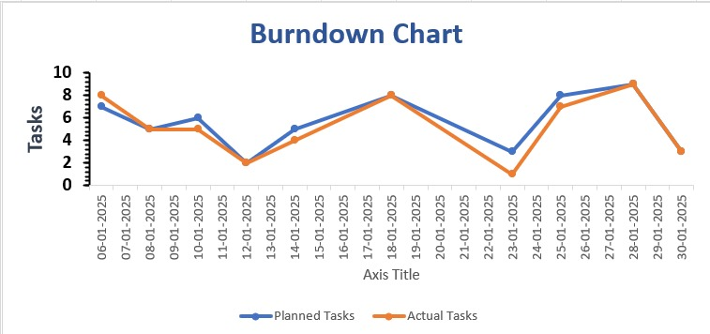
5.8 Earned-Value Burned Chart

Slide 55
6. Proposed Enhancement:
We try to implement SMS functionality in our system like sending weakly student reports.
Try to implement online payment facility.
Try to implement automated testing functionality.
Make a common web application that multiple courses for student who can use it.

Slide 56
Thank You

